Slide 1
Common Core State Standards
English Language Arts

Slide 2
Objectives
Understand where Common Core State Standards came from and why we are adopting them
Explore the relationship between the College and Career Readiness Anchor Standards and the Common Core State Standards for English Language Arts (ELA CCSS)
Examine a few key shifts related to the content of the CCSS
Think about the impact for ELAC/DELAC

Slide 3
Where they came from
ELA College and Career Readiness Standards Work Group
National Governors Association Center for Best Practices (NGA Center)
Council of Chief State School Officers (CCSSO)

Slide 4
Why we are doing this

Slide 5
Why we are doing this, cont.

Slide 6
How many states have adopted?

Slide 7
Features of the Standards
Aligned with college and work expectations
Focused and coherent
Include rigorous content and application of knowledge through higher-order skills
Build upon strengths and lessons of current state standards
Based on evidence and research
Internationally benchmarked

Slide 8
Design and Organization
Introduction
Description of capacities of a literate student (e.g., demonstrate independence, come to understand other perspectives and cultures)
Three main sections
K−5 cross-disciplinary
6−12 English language arts
6−12 literacy in history/social studies, science, and technical subjects
Three appendices
A: Research and evidence; glossary of key terms
B: Reading text exemplars; sample performance tasks
C: Annotated student writing samples

Slide 9
Standards for K-5
Grades K-5
10 Reading Standards for Literature
10 Reading Standards for Informational Text
10 Writing Standards
6 Speaking and Listening Standards
6 Language Standards

Slide 10
Standards for 6-12
Grades 6-12
English Language Arts
10 Reading Standards for Literature
10 Reading Standards for Informational Text
10 Writing Standards
6 Speaking and Listening Standards
6 Language Standards
History/Social Studies, Science, and Technical Subjects
10 Reading Standards for Literacy
10 Writing Standards for Literacy

Slide 11
Strands and Shifts
Reading
Attention to text complexity
Balance of literature and informational texts
Writing
Emphasis on argument and informative/explanatory writing
Speaking and Listening
More formal and informal communication
Language
Vocabulary, grammar, and conventions

Slide 12
Building Knowledge Through Content-Rich Nonfiction
Much of our knowledge base comes from informational text
Informational text makes up the vast majority of required reading in college/workplace (80%)
Informational text harder for students to comprehend than narrative text
Yet students are asked to read very little of it in elementary (7 - 15%) and middle school

Slide 13
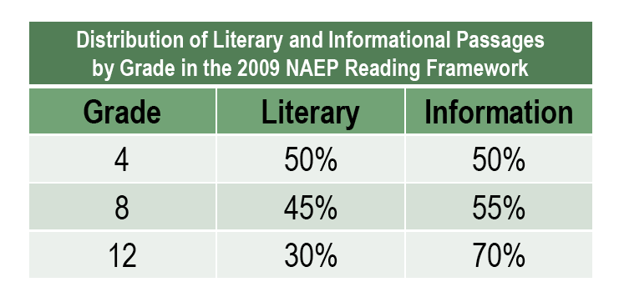
Emphasis on Informational Text
The Standards aim to align instruction with this National Assessment of Educational Progress (NAEP) framework
Percentages do not imply that high school ELA teachers must teach 70% informational text; they demand instead that a great deal of reading should occur in other disciplines
Common Core State Standards page 5

Slide 14
Three types of writing

Slide 15
Emphasis on Argument and Informative/Explanatory Writing
Arguments seek to make people believe that something is true or to persuade people to change their beliefs or behavior.
Arguments are used for persuasion and explanations for clarification.
Explanations start with the assumption of truthfulness and answer questions about why or how. Their aim is to make the reader understand rather than to persuade him or her to accept a certain point of view.
Narrative writing conveys experience, either real or imaginary, and uses time as its deep structure.

Slide 16
Literacy standards for reading and writing in history/social studies, science, and technical subjects
Shared responsibility of content teachers to teach reading and writing.
Opportunity to incorporate a variety of reading and writing activities in content areas.
Complement rather than replace content standards in those subjects.

Slide 17
Resources
National Common Core Standards: www.corestandards.org
Additional Information About CCSS: http://www.achievethecore.org/
Tools for Informational Text: http://helloliteracy.blogspot.com/2011/02/sources-of-short-web-based-text.html
Sam Facendini (ELA-CCSS): sfacendini@scoe.org
Karen McGahey (CCSS): kmcgahey@scoe.org

